Slide 1
Network Topology and Switching
Course Code: COE 3201
Course Title: Data Communication
Dept. of Computer Engineering
Faculty of Engineering
Lecture No: | 11 | Week No: | 13 | Semester:
Lecturer:

Slide 2
Lecture Outline
Network topologies
Switching Mechanism for Data Transfer
Circuit Switching
Message Switching
Packet Switching
Virtual Circuit Switching
Datagram Switching

Slide 3
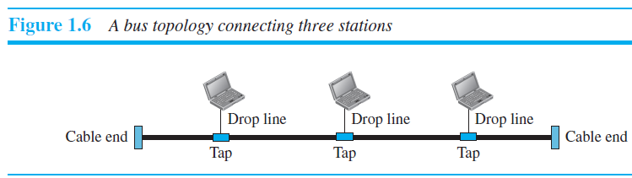
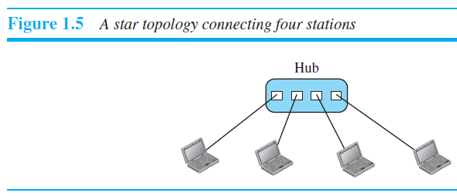
Network topologies

Slide 4
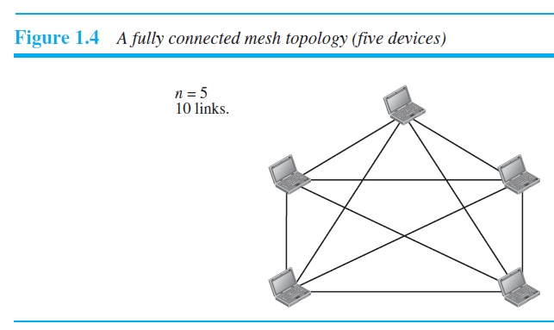
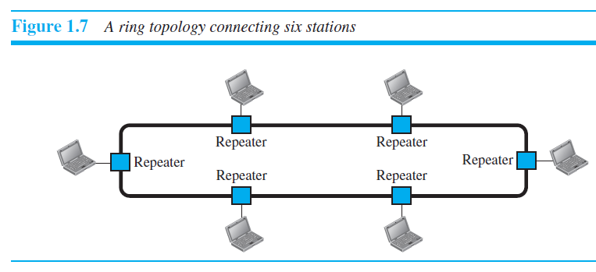
Network topologies

Slide 5
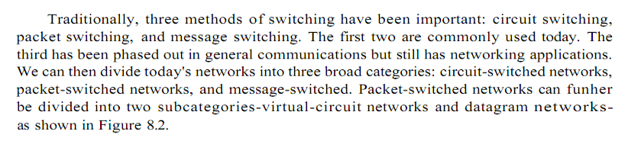
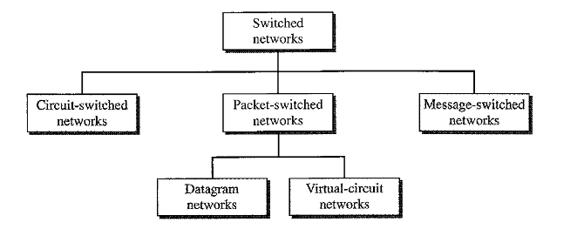
Switching Mechanism for Data Transfer
Taxonomy of Switched Network

Slide 6
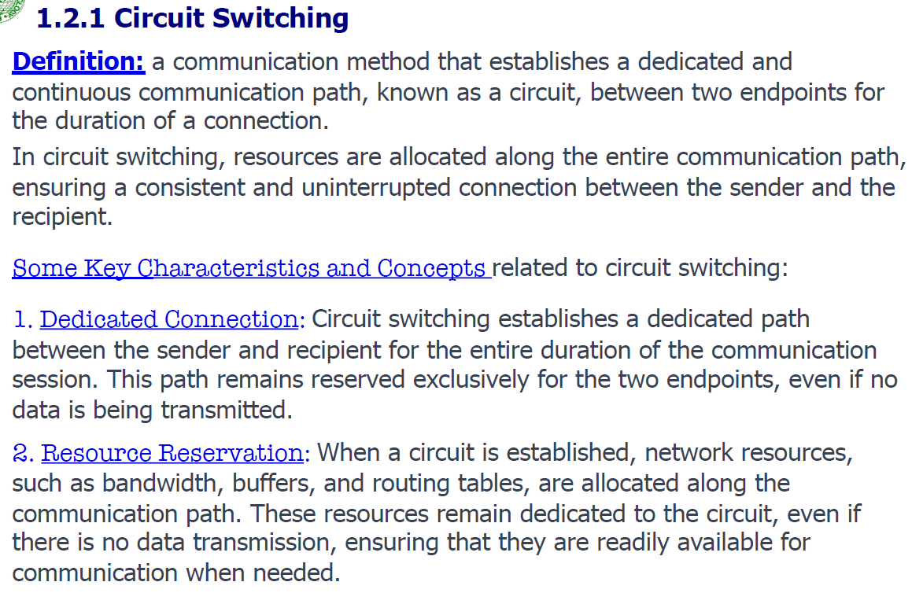
Circuit Switching

Slide 7
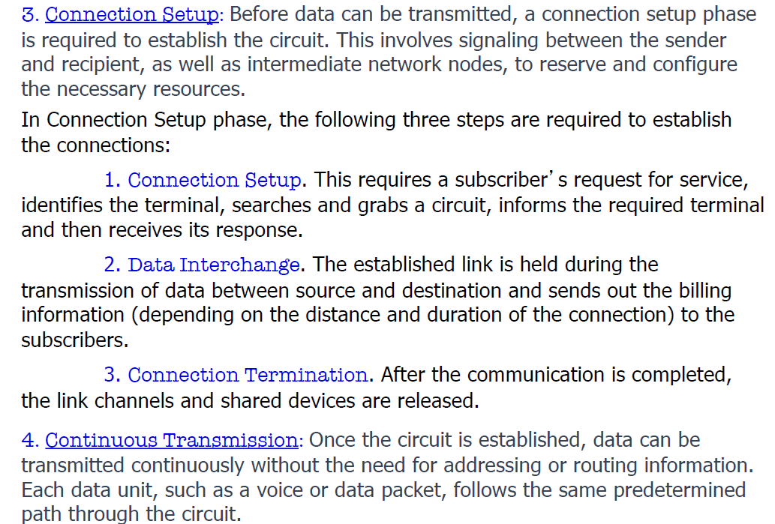
Circuit Switching

Slide 8
Circuit Switching
A
B
Node 1
Node 2
DATA
processing delay at Node 1
propagation delay
between A
and Node 1
Set-up phase
propagation delay
between B
and A
Data Transfer phase
Teardown phase

Slide 9
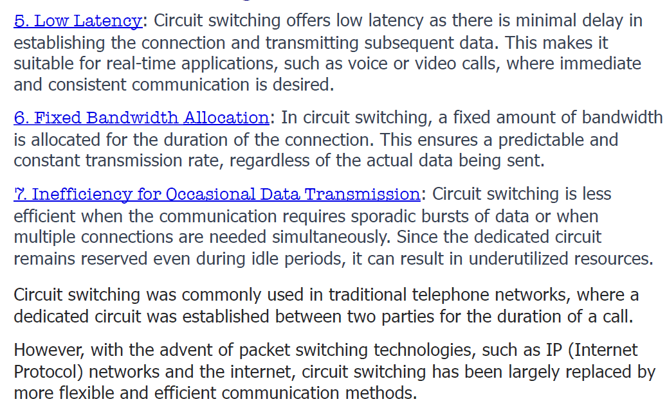
Circuit Switching

Slide 10
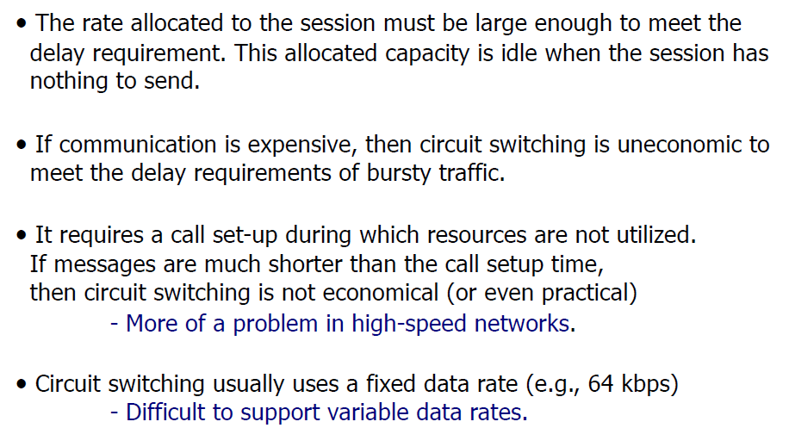
Limitations in Circuit Switching

Slide 11
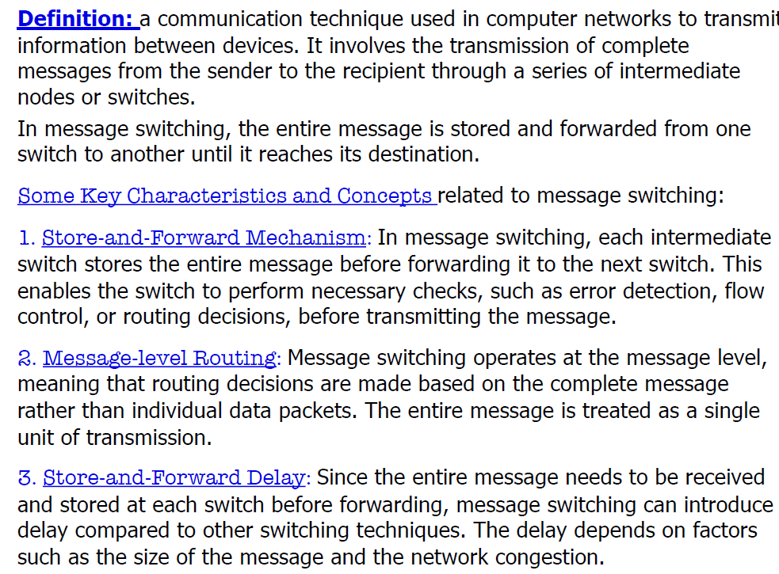
Message Switching
Header
Data

Slide 12
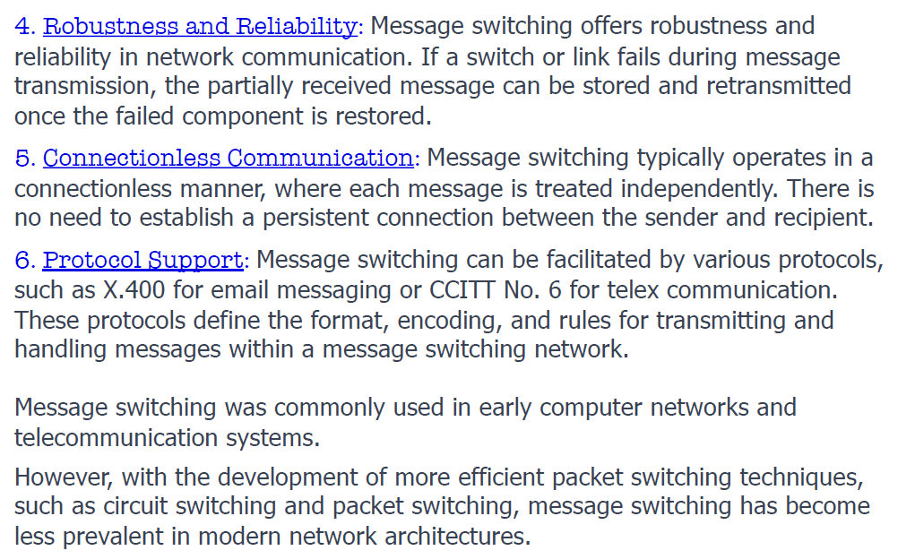
Message Switching

Slide 13
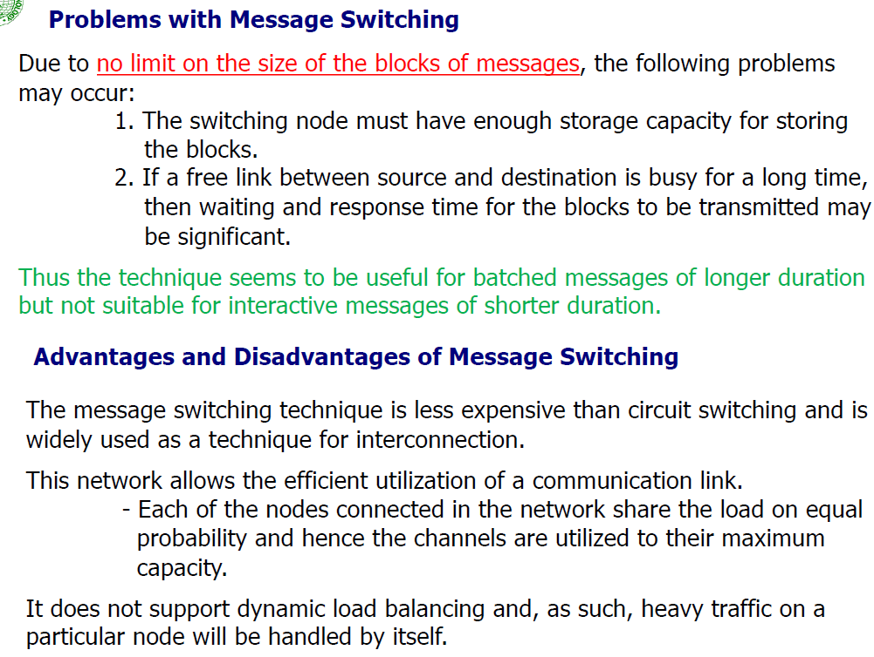

Slide 14
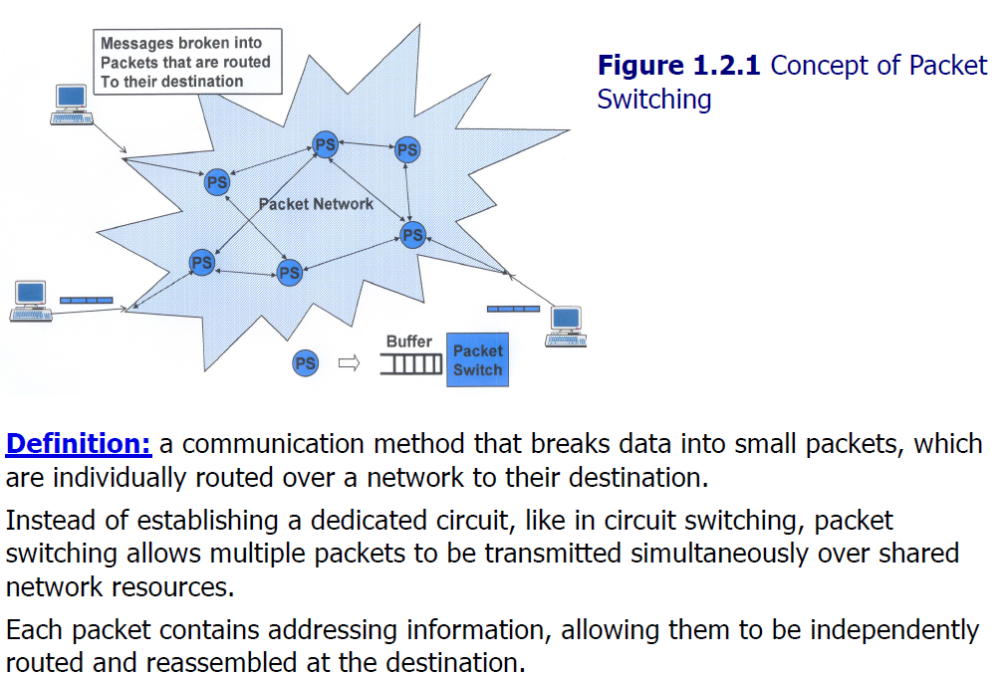
Packet Switching

Slide 15
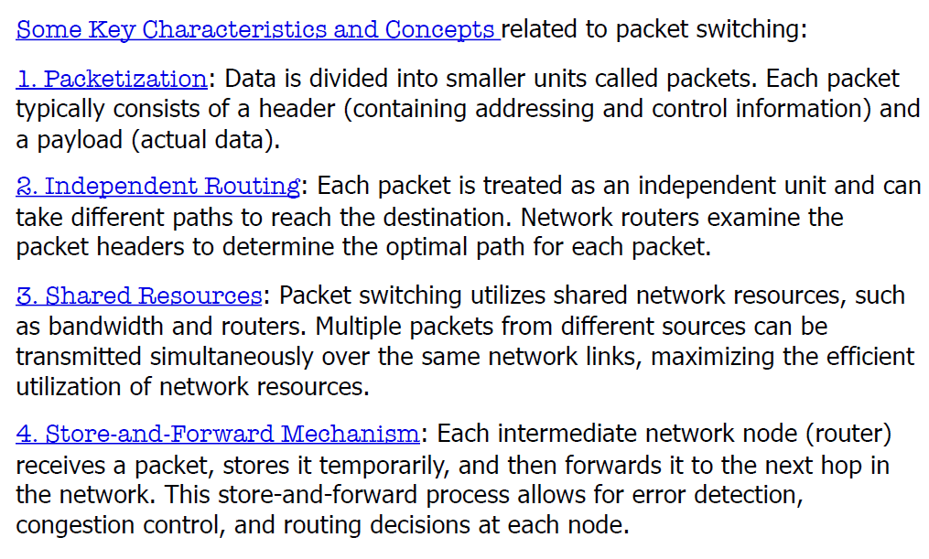
Packet Switching

Slide 16
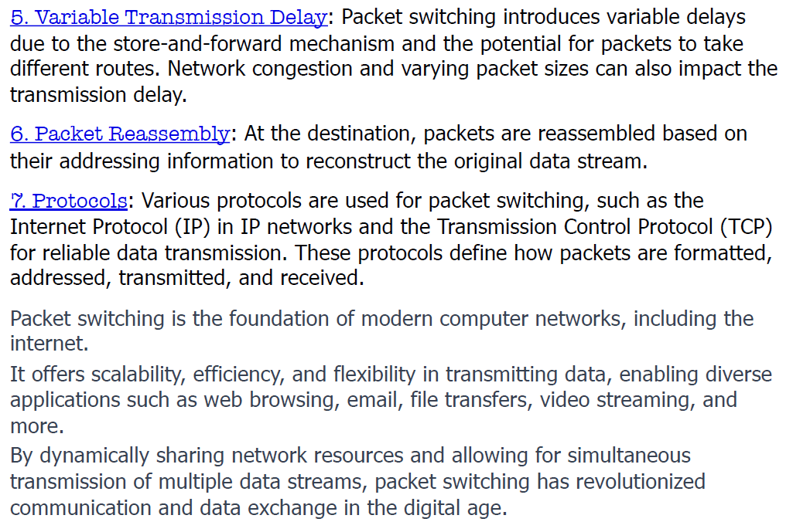
Packet Switching

Slide 17
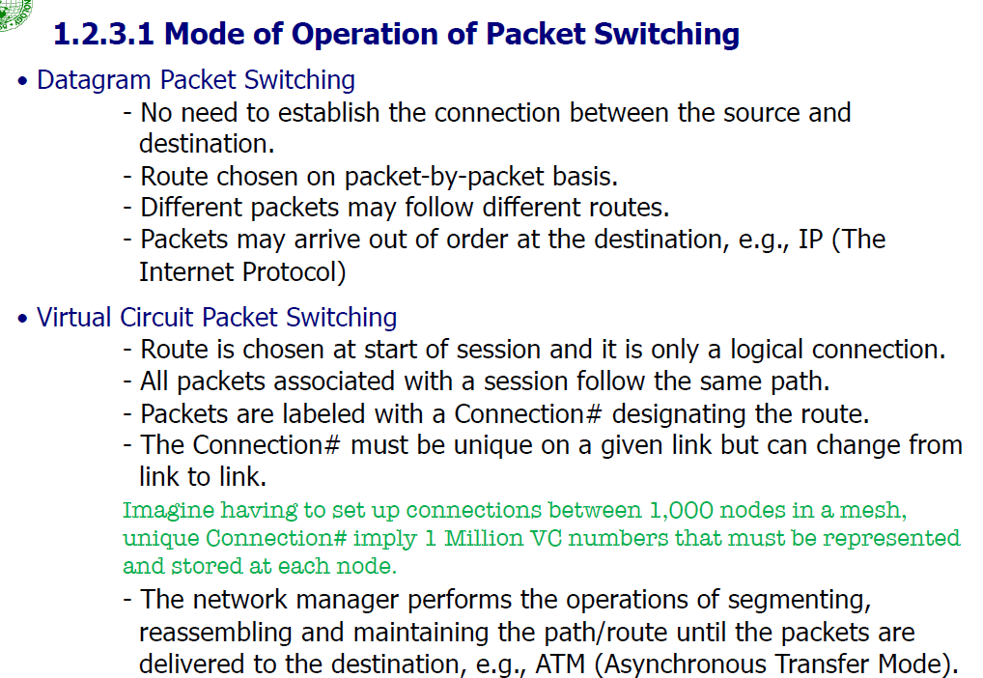

Slide 18
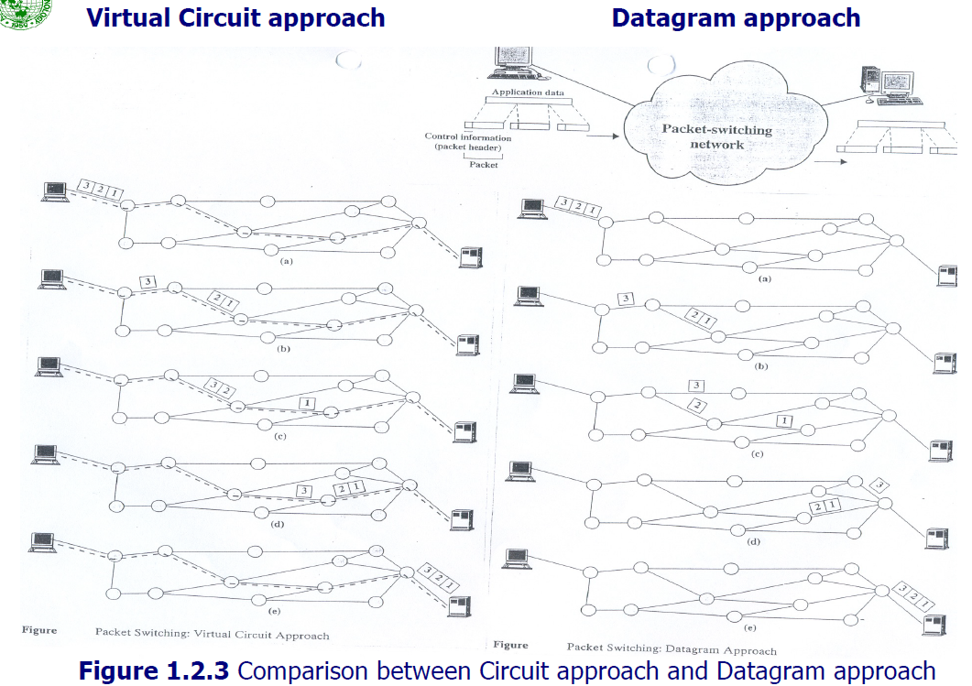

Slide 19
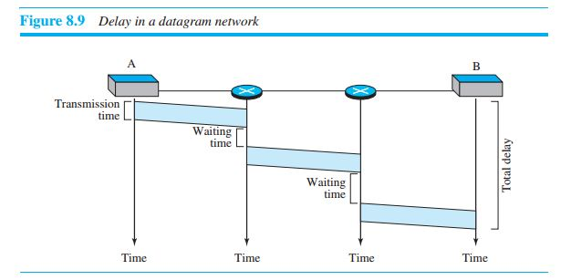
Delay in datagram network
There are three transmission times (3T), three propagation delays (slopes 3τ of the lines), and two waiting times (w1 + w2). We ignore the processing time in each switch.
The total delay = 3 T + 3 τ + w₁ + w₂

Slide 20
Virtual-Circuit Packet Switching
A virtual-circuit network is a cross between a circuit-switched network and a datagram network.
Preplanned route established before any packets sent
Resources can be allocated: predefined/on-demand
Call request and call accept packets establish connection (handshake)
Communication with virtual circuits takes place in three phases
VC establishment
data transfer
VC disconnect

Slide 21
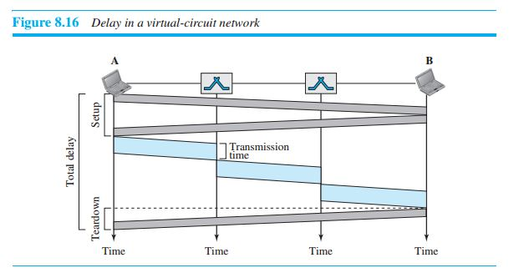
Delay in a virtual-circuit network
There are three transmission times (3T ), three propagation times (3τ),
A setup delay, and a teardown delay. We ignore the processing time in each switch.
The total delay time is
Total delay = 3T + 3τ + setup delay + teardown delay

Slide 22
Datagram vs. Virtual-Circuits Packet Switching
Datagram | Virtual circuits
No call setup phase Better if few packets More flexible Routing can be used to avoid congested parts of the network | Network can provide sequencing and error control Packets are forwarded more quickly No routing decisions to make Less reliable Loss of a node loose all circuits through that node

Slide 23
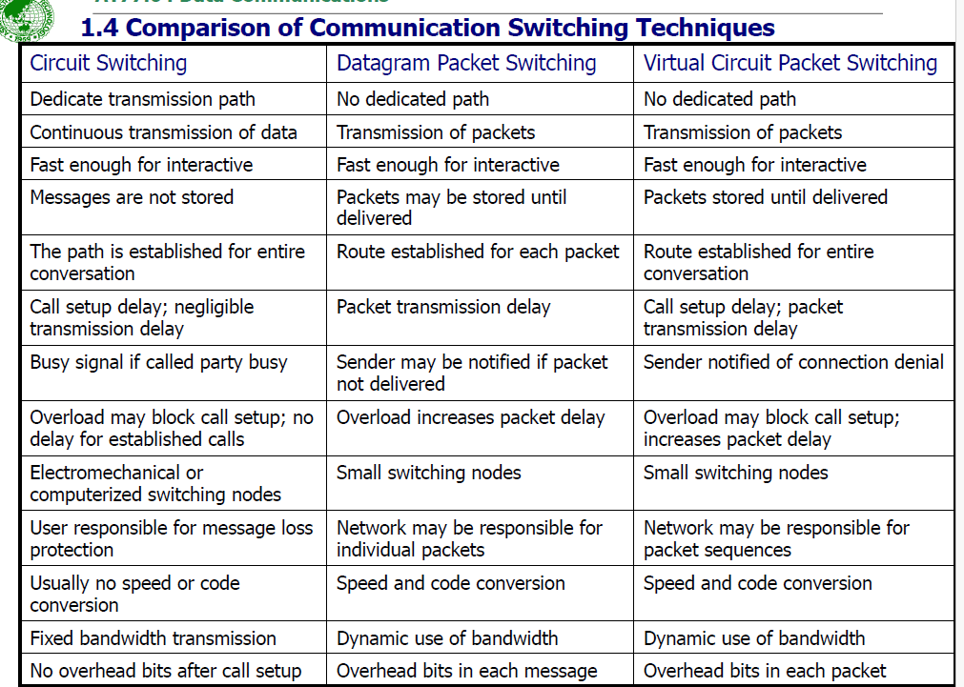

Slide 24
Books
1. Forouzan, B. A. "Data Communication and Networking. Tata McGraw." (2005).

Slide 25
References
1. Prakash C. Gupta, “Data communications”, Prentice Hall India Pvt.
2. William Stallings, "Data and Computer Communications”, Pearson
3. Forouzan, B. A. "Data Communication and Networking. Tata McGraw." (2005).

